Slide 1
PROBLEM STATEMENT
Water level measurement within the water tanks.
Making water pumps to respond automatically when required.
Detecting water wastage (leakage in pipelines, running taps, overfilling of water tanks).
Reading Water contamination problems, i.e. Chlorine, pH levels.
Reading water consumption on a daily basis.
Disproportionate consumption of water by apartments when connected to a single overhead tank or underground reservoir.
Storing data for further analysis.
Not having proper routes for water supply.
Visualization and control of complete system at one place.

Slide 2
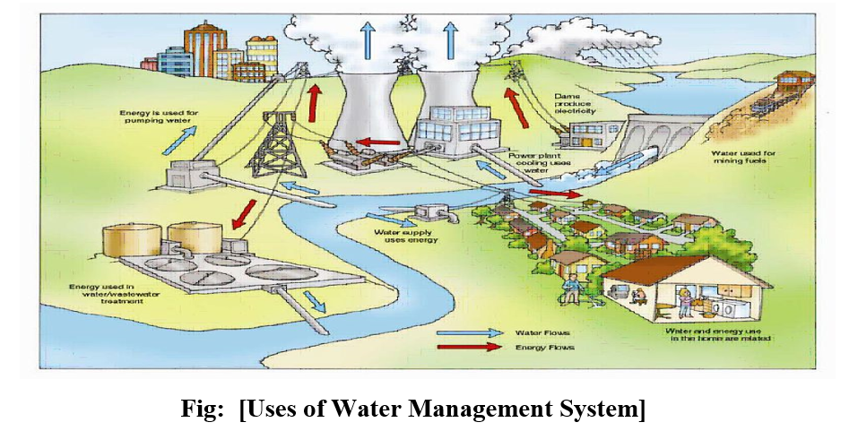
Why to use our Smart Water Management System?
Smart water management systems can provide a more resilient and efficient water supply system, reducing costs and improving sustainability.
The workshop introduced smart systems and focused on remote monitoring of water networks using smart meters and sensor.
Provide different variants of system with different costs ranging from lower to higher costs
Water leakage detection.
More efficient systematic water management with high accuracy and prefection.
Quality control on water reserves.
Prescriptive maintenance on infrastructure.
Low maintenance costs.
Android/ios based application
One click additional water request.
Free maintenance and services for 1 year.
Transparency on consumption.

Slide 3
REQUIREMENT
Why We Require Smart Water Management System?
LEAK DETECTION SOLUTION
1. Detect pipeline leakage in real-time
2. Get real-time notification alerts
3. Monitor underground pipelines
4. Reduce water wastage
AUTOMATIC METER READING SOLUTION
1. Increase billing accuracy
2. Better water usage management
3. Eradicate manual reading
4. Match demand and ply
WATER QUALITY MONITORING SYSTEM
1. Conductivity Measuring
2. Salinity Measuring
3. Ph Measuring
4. TDS Measuring

Slide 4
Sensors
“The Internet of Things is one of the most important and promising technological topics today. Some market researchers estimate that there are more than 20 billion connected devices and counting. Around us, there are smartphones, wearables, and other devices, all of which use sensors.”
“In this report, we are using a variety of sensors and other devices. Before using any sensor we give to spend a lot of time in research and other things to the choice the best sensor on the basis of the following feature : ”
It should be sensitive to the phenomenon that it measures
It should not be sensitive to other physical phenomena
It should not modify the measured phenomenon during the measurement process.

Slide 5
List of Sensors Used in Project:
1. Lora MQTT Gateway esp32 | 9. Tx Rx module
2. 1000L Tank | 10. Ph Sensor
3. Water Filter | 11. Turbidity Sensor
4. Router | 12. Optical Level Sensor
5. Carbon Nanotube | 13. Relay
6. AC-DC Converter | 14. Flowmeter
7. Superhet Receiver | 15. Overflow Sensor
8. ESP8266 | 16. Buzzer

Slide 6
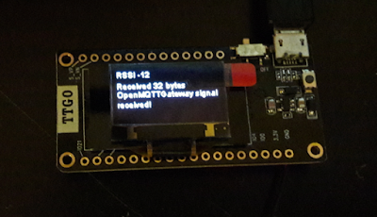
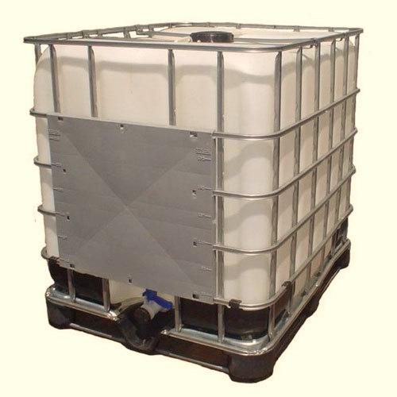
1. Lora MQTT Gateway esp32
These modules combined with OpenMQTTGateway enables to send LORA messages coming from MQTT message,
here is an example:
mosquitto_pub -t home/OpenMQTTGateway/commands/MQTTtoLORA -m '{"message":"OpenMQTTGateway signal received!"}'
Fig: Lora RF
2. 1000L Tank
This Tank is Used to Store the Water which are Used for Purification .and this tank is not fixed so we can chage its place according to our Need.
Fig: 1000L Tank

Slide 7
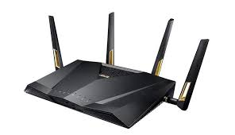
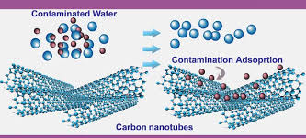
3. Router
The main purpose of a router is to connect multiple networks and forward packets destined either for its own networks or other networks.
Fig: Router
4. Carbon Nanotube
This is a tube made of carbon fiber sheet which even cleans seawater and makes it available to drink.
Fig: Carbon Nanotube

Slide 8
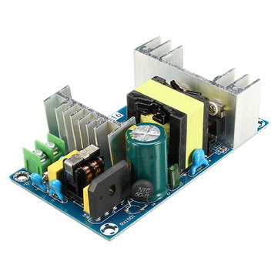
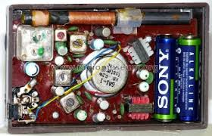
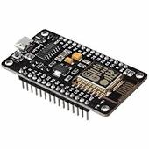
5. AC-DC Converter
It converts the ac current to dc current for our sensor as we know all our seniors work on dc.
Fig: AC-DC Convertor
6. Superhet Receiver
This is a receiver with its full name superheterodyne receiver.it ranges up to 150 m and the data transfer rate is so fast nearly(0.125sec).
Fig: Superhet Receiver
7. ESP8266
It is the best mcu device because of its wifi capabilities(802.11 b/g/n/e/i) better than arduino uno.
Fig: ESP8266

Slide 9
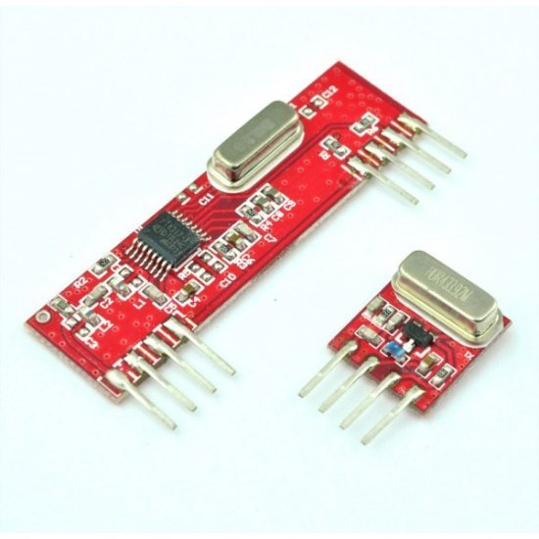
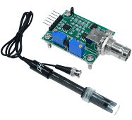
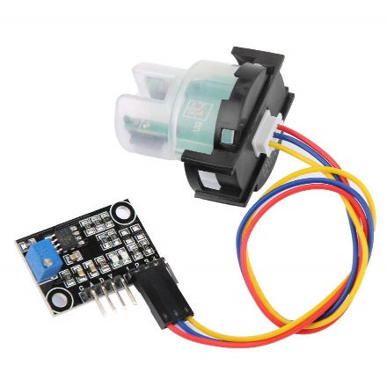
8. Tx Rx module
This is a set of transmitters and receivers. Transmitting data from one end and receiving it on another end.
Fig: Tx Rx Sensor
9. Ph Sensor
A pH sensor is one of the most essential tools that's typically used for water measurements. This type of sensor is able to measure the amount of alkalinity and acidity in water and other solutions.
10. Turbidity Sensor
Fig: PH Sensor
Turbidity is an important indicator of the amount of suspended sediment in the water, which can have many negative effects on aquatic life. The suspended sediments that cause turbidity can block light to aquatic plants, smother aquatic organisms, and carry contaminants and pathogens, such as chlorine, lead, mercury, and bacteria.

Slide 10
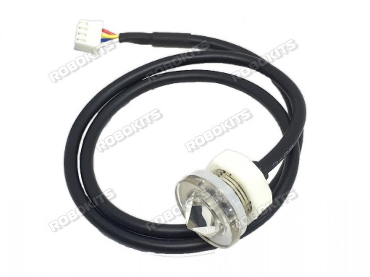
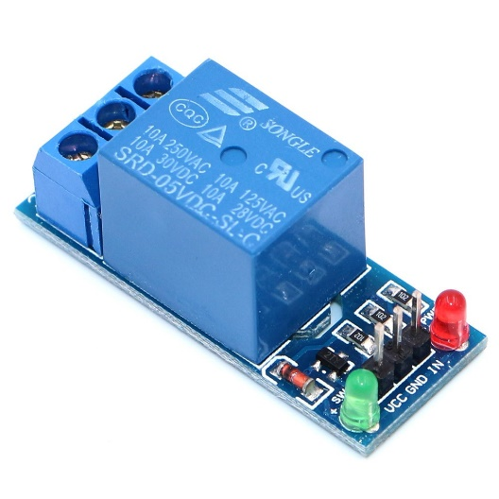
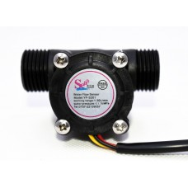
11. Optical Level Sensor
Optical level sensors are used to detect liquids including poised materials, interface between two immiscible liquids, and the occurrence of sediments. They are worked based on the changes in transmission in infrared light emitted from an IR LED. They are commonly used in leak detection and tank level measurement
Fig: Optical Level Sensor
12. Relay
A relay is an electrically operated switch. It consists of a set of input terminals for a single or multiple control signals, and a set of operating contact terminals. The switch may have any number of contacts in multiple contact forms, such as making contacts, break contacts or combinations thereof.
Fig: Relay
13. Flow Meter
A flow meter is a device used to measure the volume or mass of a gas or liquid. ... Or more frequently, the most utility from a flow meter and the greatest variety of flow meters focus on measuring glasses and liquids in a pipe.
Fig: Flow Meter

Slide 11
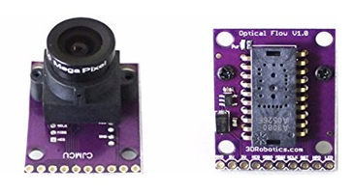
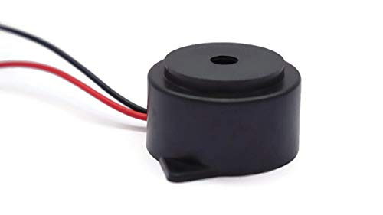
14. Overflow Sensor
In order to meet the diversified cleaning needs of several industries, we are instrumental in providing a qualitative Overflow Water Sensor service. ... This sensor service is exclusively executed to raise an alarming call, on water outflowing of the water tank.
Fig: Overflow Sensor
15. Buzzer
A buzzer or beeper is an audio signalling device, which may be mechanical, electromechanical, or piezoelectric (piezo for short). It will execute an alarming call when there is any problem with a sensor.
Fig: Buzzer

Slide 12
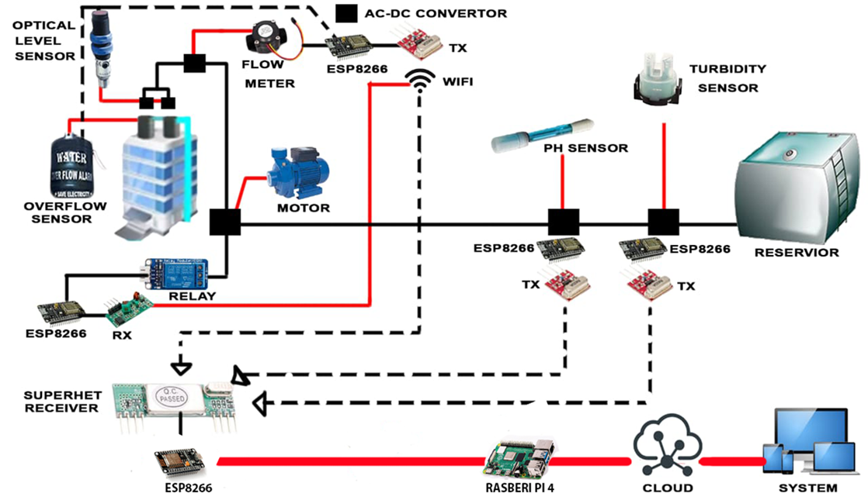
NETWORKING
After verifying all the sensors and other devices for our project Smart Water Management System the main problem is how to connect them in such a way that we can use their full potential for best performance.
With a lot of research and reference* we came up with our networking of water management systems for 10 buildings. Here is the basic design of our project given below…
Fig 2.1 Basic Networking for a building

Slide 13
As we can see in above fig is the whole structure for a building. As we can see the whole system work on Wi-Fi. Here we used Tx & Rx for transmitting and receiving the data between every sensor and device.
Every two buildings are connected with 1 Lora Wan through which all the data from the buildings go to the cloud. Which we can excess through our system (like a computer, tablet, and phone) through an internet connection. Since Lora Wan works on the internet so we are using two wide-range routers as shown in the fig.
We have classified our project into 3 categories based on society.
A grade society
B grade society
C grade society ( under government control )

Slide 14

But before moving toward our various society we would like to present our core architecture for 1 building
Fig 2.2 Core Architecture

Slide 15
This is the core structure of our project which gives the idea of how our model is working with various sensors and other devices. As for the communication between every sensor and device we are using Tx & Rx for transmitting and receiving the data so that the whole system becomes wireless and works on wifi. All the real-time data will be received by the Superhet Receiver, sent to the system in the form of the datasheet. Now move toward our sensor and other devices. As we can see water is supplied to all the buildings through an underground water reservoir. Through a turbidity sensor and pH sensor, we check the contaminant present and pH of the water before delivering it to all the buildings. After that, we used a relay that turns on/off the motor as per the signal received through Rx. In every building, we used a level sensor, overflow sensor, and water meter. Level sensors provide a signal through Tx when every water level is below the requirement and turn on the motor. It all used to detect leakage in the system. As for the overflow sensor, it generates an alarm as well as a signal to turn off the motor. And as for the water meter as we get it from its name it is installed in every building to give the data of water consumption of every building and help us to maintain water management and minimize the water leakage in the society.

Slide 16
Silence feature of our project :
The whole architecture is user friendly and does not require any complex engineering.
Totally wireless system.
Recycle and remove all the containment present in water coming out of the building.
Include a purification system to purify water and recycle it.
Fully smart and cost-efficient.

Slide 17


